Slide 1
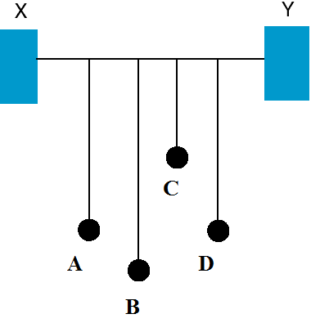
Resonance
Demonstration 1: What happens when pendulum A is set in motion?
Observation 1: All the pendulums vibrate a little, BUT pendulum D which is matched in length and frequency vibrates A LOT.
D takes up the energy from A because it has the same natural frequency!

Slide 2
Resonance
Standing waves are examples of a resonance phenomenon!
Resonance: the transfer of energy to an object at the natural or resonant frequency of the object.
Because the input energy is matched to the natural frequency of the object, it is able to develop very large amplitude vibrations!

Slide 3
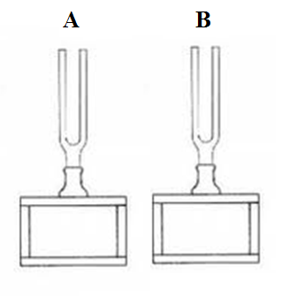
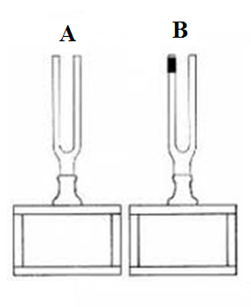
Matched Tuning Forks
Demonstration 2a: A and B are matched (identical frequency). What happens when A is struck?
B begins to ring as well because it is able to pick up the energy!
Demonstration 2a: B is now loaded so that has a lower frequency, what happens when A is struck?
B does NOT ring because it can’t pick up the energy from A!
Matched tuning fork demonstration

Slide 4
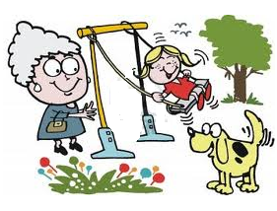
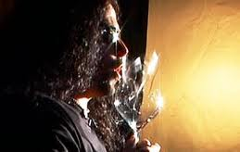
Examples of Resonance:
Pushing a child on a swing
Shattering a wine glass with a voice
Windows on a car rattling when driving at a certain speed
Shattering a wine glass with your voice!
The Tacoma Narrows Bridge collapse!
Classwork Homework:
Read Pages 315-316 Questions: #10 , 11,13 pg 317
Tacoma narrows bridge collapse video…

